Slide 1



Revealing the Promised Land:
Synergy for Achieving Financial Excellence
9th AUGUST 2017 || Technically Driven. Intrinsically Motivated.
ELITE BANK
Charles WONG | Ken CHEUNG | Michelle MA
Notes:
版权声明：300套精品模板商业授权，请联系【锐旗设计】:https://9ppt.taobao.com，专业PPT老师为你解决所有PPT问题！

Slide 2







A Glimpse of Price Discrepancy in Securities Trading
ELITE BANK
Price Discrepancy as a Twofold Problem
Crisis Management Team
Michelle MA
Vice President, Equity Sales and Trading
User Acceptance Testing
Regulatory Compliance
Charles WONG
Senior Manager, Technology and Operations
System Surveillance
Data Integrity Management
Unreliable External
Data Sources
Wrong Capturing
of Spot Price
Ken CHEUNG
Senior Manager, IT Infrastructure
System Automation
Algorithm Development
MarketBox is a warehouse which stores market movement data, and oftentimes reporting errors occurs due to reliance on single external data source
MoneyClip is where price discrepancy can occur due to the inappropriate instructions and inconsistent treatment of how spot price should be taken
Source: Goldman Sachs, Accenture, EY 2016 Capital Markets Report, BCG Global Markets 2017 Report, Elite Bank Analysis
Situation Analysis | Technological Synergy | Operational Synergy | Implementation and Benefits | Page 02

Slide 3
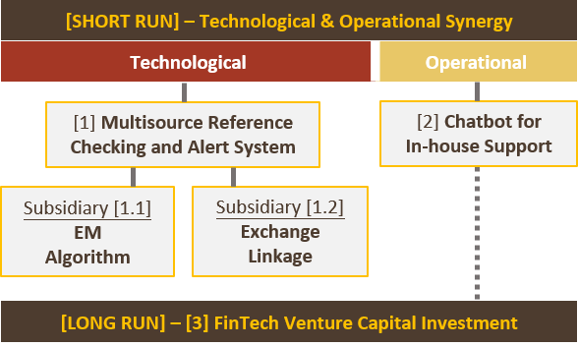
Elite Bank for the Winning Edge: Synergy Overview
ELITE BANK
Intrinsically Motivated, Technically Driven.
Problem(s) |  |  | Suggested Perspective(s) | Solution(s) | Mitigation Ability
Technological | 1 | Unreliable External Data Sources | Front-to-Back Trading Cycle Improvement | Multisource Referencing & Alert System | 87%
 | 2 | Wrong Capturing of Spot Price | Improvement of Timeliness & Efficiency | EM Algorithm & Exchange Linkage | 91%
Operational | 3 | High Maintenance Manpower Cost | Operational Risk Controls | Chatbot for In-House Support | 80%
 | 4 | In-house System Incompetence | Cost Reduction via Offshoring & Outsourcing | FinTech Venture Capital Investment | 83%
Source: Morgan Stanley, HKMA, EY 2016 Global banking Outlook, World Economic Forum, Elite Bank Analysis
Situation Analysis | Technological Synergy | Operational Synergy | Implementation and Benefits | Page 03

Slide 4
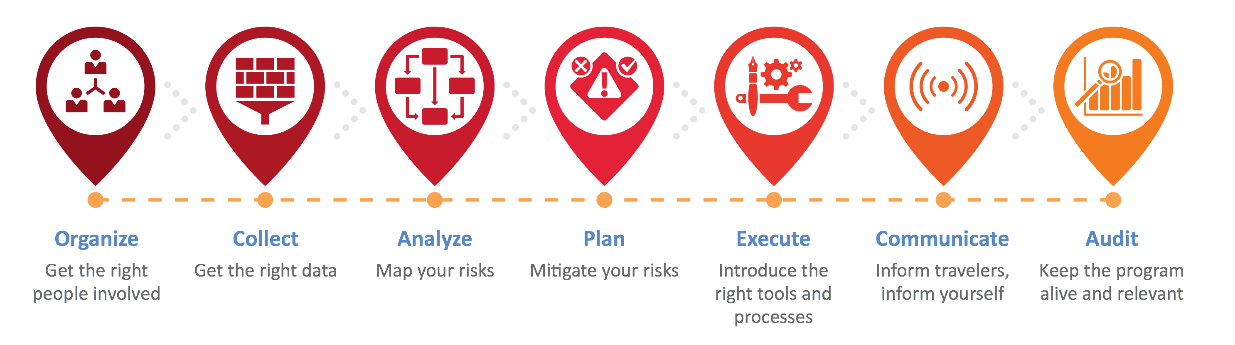








[1] Multisource Reference Checking and Alert System
ELITE BANK
Purpose and Rationale
Price discrepancy risk is not mitigated if Elite Bank continues to lean on single data source for compiling daily profit and loss. To capture a more accurate market price, it is advisable to have at least one more market data source for comparison purpose.
Cross-checking is therefore necessary to confirm the data accuracy, especially during the market-close period.
Global Securities Databases with Most Subscriptions
Harvard Business Review Industrial News
Trading Speed for Jeopardy: 2012 Knight Capital Trading Disruption
The 2012 Knight Capital Incident in U.S. related to the deployment of untested trading software to which contained an obsolete function, causing $400 million expense in an attempt to stay in business after the trading error.
Whenever there is a price discrepancy among databases, the alert system will be triggered and corrective actions must be taken.
Source: Societe Generale Group Analysis, Financial Times, Forbes, Harvard Business Review, HKEx, HKMA
Situation Analysis | Technological Synergy | Operational Synergy | Implementation and Benefits | Page 04

Slide 5
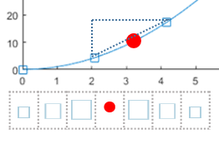


[1.1] EM Algorithm for Estimation of Missing Entries and Trends
ELITE BANK
The Stochastic Expectation-Maximization (EM) Algorithm
Simulation and Asymptotic Results
Expectation-Maximization (EM) algorithm is a general, iterative algorithm for parameter estimation by maximum likelihood when random variables involved in a time series are not served (i.e. missing stock prices in certain time stamps). Missing data points can be estimated through multiple layers of simulations, the trendline of a certain stock can therefore be generalized.
Simplified Data Log-Likelihood (Rubin 1976):
F(θ|Y observation) = f1 (θ|Y) –
Log [ f2 (Y missing |Y observation ;θ) ]
Elite bank recognizes the quotes provided by exchanges should be the most reliable data. However, the deployment of EM algorithmic machine learning system can be utilized as preliminary parameters for alert trigger, in accordance with the mean squared errors of deviant data points.
Suppose the red dot indicates a missing data point, whereas the blue squares are subsets of the time series plot. The value of red dot is computed by simulating the expected value through observing the whole dataset.
Generalization of Missing Entries
Real-Time Trendline
Smoothing
Source: Doz, C., Giannone, D., & Reichlin, L. (2012). A quasi–maximum likelihood approach for large, approximate dynamic factor models
Situation Analysis | Technological Synergy | Operational Synergy | Implementation and Benefits | Page 05

Slide 6
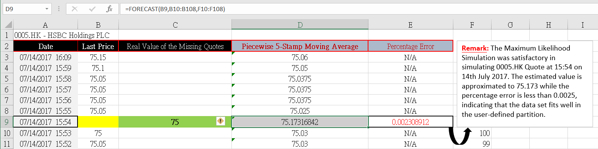
[Prototype Demonstration 1.1]: EM Algorithm
ELITE BANK
 | =Missing Value
 | = Estimated Value Using Maximum Likelihood Simulation
 | = Real Minute Quote from Bloomberg
Source: G. Andrew Karolyi. (2015). Cracking the Emerging Markets Enigma.
Situation Analysis | Technological Synergy | Operational Synergy | Implementation and Benefits | Page 06

Slide 7







[1.2] System Linkage with Exchange
ELITE BANK
Exchange Linkage as the Second Line of Defense
New York Times Industrial News
In case the emergency alert is triggered due to the inconsistency of market data from Bloomberg and Reuters, data from the exchange determines the closing price of the securities. For securities traded on the exchange, data from the exchange must be reliable.
Monday’s Plunge in the Yuan Freaked Out China Watchers
Inconsistency
In December 2016, professional traders using Bloomberg terminals observed the yuan spot prices from a dozen banks all hovering around the actual price of 6.86/$1. Then there was ICAP’s ask price at 7.48 to $1. Reasons for capturing erroneous yuan exchange rate were still unclear.
Data Integrity Checking
Essential Stock information Available at Exchange Houses
HKEx Subscription Fee
($ in HKD)
Entry Level Package (Morning & market close) | 500
One Cross Connect | 1500
Daily Market Reports –Futures & Options | 600
Monthly Recurrent Fee ($) | 2600
Hong Kong Stocks
U.S. Stocks
Comprehensiveness
Essential stock information, such as high, low,
closing price and turnover are fully disclosed
Futures & Options
Accuracy
Stock and Option Data is directly obtainable from where these derivatives are traded
Source: HKEx. (2017). HKEx Market Data Services: Real-time Securities Market Data, Bank of America Merrill Lynch
Situation Analysis | Technological Synergy | Operational Synergy | Implementation and Benefits | Page 07

Slide 8


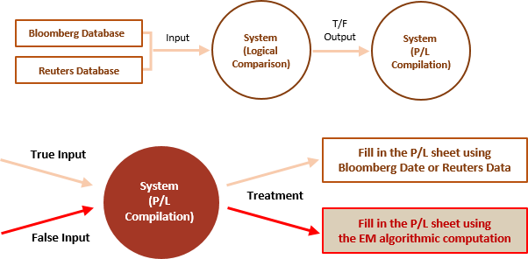
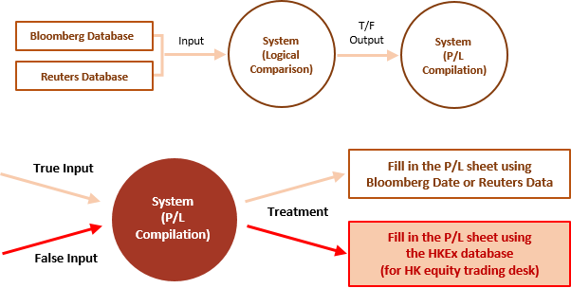
Scenario Analysis: Multisource Referencing & Alert System
ELITE BANK
[1.1] Real Time Data Feeding – EM Algorithm
[1.2] Market Closing – Exchange Linkage
Source: U.S. Securities and Exchange Commission. (2014). Deutsche Bank Securities Complaints.
Situation Analysis | Technological Synergy | Operational Synergy | Implementation and Benefits | Page 08

Slide 9
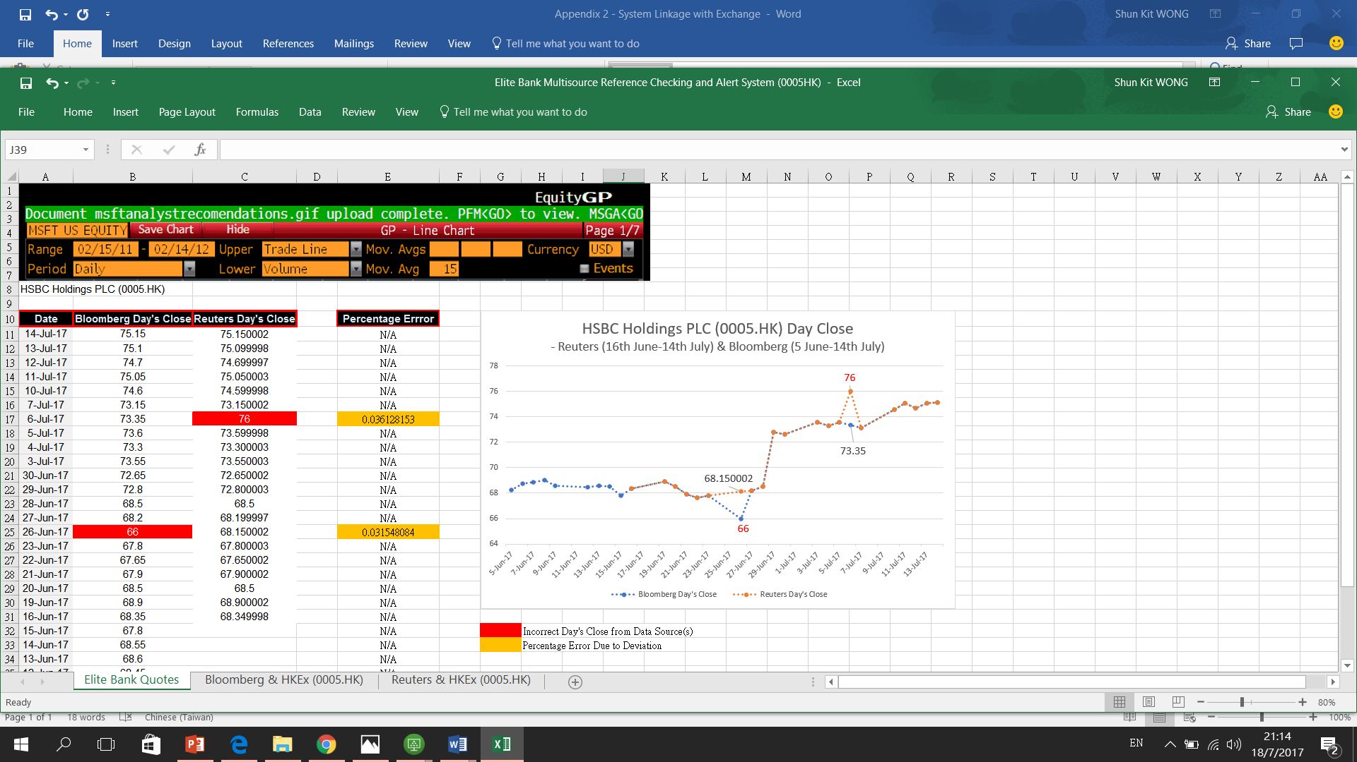
[Prototype Demonstration 1.2]: System Linkage with Exchange
ELITE BANK
Source: Thomson Reuters. (2016). Accessing Rates via Bloomberg - Thomson Reuters, HKEx, SFC, HKMA, Elite Bank Analysis
Situation Analysis | Technological Synergy | Operational Synergy | Implementation and Benefits | Page 09

Slide 10

[2] Chatbot for In-House Support
ELITE BANK
Artificial Intelligence Bot as Elite Bank’s Reliable Solution Tank
Rediscover, Resolve, Refine
With the help of Chatbots or conventional robotic advisors, instant feedback can be generated with preset computerized program designated to simulate an intelligent conversation with one or multiple human users, in natural language via auditory or textual methods.
1
2
3
P&L corrections were unable to be completed due to the lack of workforce in the
Data Integrity Team
a) Generating instant feedback with 90% of relevance and it is available 24/7
b) Striking up human-like conversations with users through answering inquiries or providing suggestions
In-House Chatbot reduces maintenance manpower expenses and minimizes flow time to mitigate operational risks
Source: BCG Analysis, Deloitte, Accenture, Forbes. (2016). UBS And Amazon Team Up For 'Ask UBS' Chatbot.
Situation Analysis | Technological Synergy | Operational Synergy | Implementation and Benefits | Page 10

Slide 11


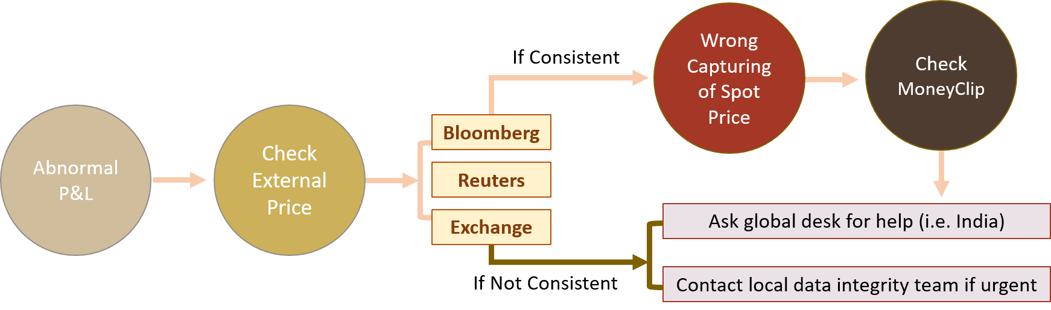
Scenario Analysis: Chatbot for In-House Support
ELITE BANK
[1] Learning to Become Familiarized with the Trading System
Chatbot can provide information of the trade system description (e.g. functions of MoneyClip) and the linkages between various systems (e.g. MarketBox and StatBox).
[2] Solving Price Discrepancy Problem
Chatbot can assist a trader to identify the root causes of abnormal P&L and advise him/her with different approaches to mitigate price discrepancy.
Situation: [1] Inaccurate External Data Sources
[2] Wrong Capturing of Spot Price
Source: Deutsche Bank, Goldman Sachs, J.P. Morgan, Elite Bank Analysis
Situation Analysis | Technological Synergy | Operational Synergy | Implementation and Benefits | Page 11

Slide 12
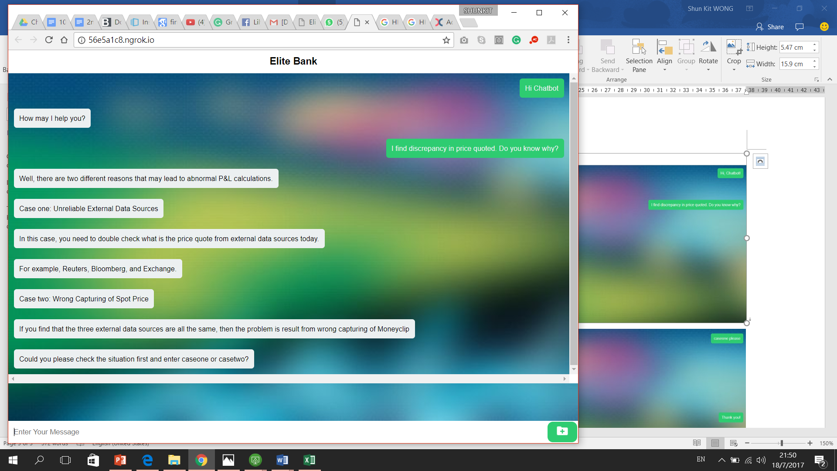
[Prototype Demonstration 2]: Chatbot for In-House Support
ELITE BANK
Case One Unreliable External Data Source
It is possible to have reporting errors occurred in Bloomberg or Reuters. Consequently, multisource reference checking is recommended. In addition, when there is price discrepancy between these two sources, double check with the Exchange and take the price quotes from it as the final reference.
Case Two Wrong Capturing of Spot Price
If there is no price discrepancy between the three external data sources (i.e. Reuters, Bloomberg and the Exchange), the occurrence of abnormal P&L generation might be attributed to inappropriate instructions set in MoneyClip.
Source: Amazon Web Services, CurrencyCloud, Oracle, IBM, Elite Bank Analysis
Situation Analysis | Technological Synergy | Operational Synergy | Implementation and Benefits | Page 12

Slide 13


Global Banking Chatbots Comparable Analysis
ELITE BANK
AI-Powered Chatbots for
Better Operational Experiences
Erica helps customers make smarter banking decisions and facilitates bill pay within the BofA app
KAI can answer inquiries about customer’s account and monitor its spending levels based on their account balance
The application of Chatbots is a time-saving and cost-efficient process, which eases the burden of system supporters, and preinstalled solution manual can be immediately delivered with 90% of relevance and is available 24/7.
Retail Banking
Digital
Services
Exposure
Back Office
Online Banking
COIN assists Operations Team to analyze legal contracts and IT Team to parse emails for employees
POSB supports customers to check current interest rates, make money transfer and connect to a bank agent via live chat
Depth
Eno announces customers their account balance, recent transactions, payment history, and credit limit via text message
Karolina can provide information to customer queries about Citibank products and services
Customer Service
Banking Account
Source: World Economic Forum, CFA Institute, EY (2016) Global banking Outlook
Situation Analysis | Technological Synergy | Operational Synergy | Implementation and Benefits | Page 13

Slide 14








[3] FinTech Venture Capital Investment for Long-Term Operational Stability
ELITE BANK
FinTech Applications in Operations Team
FinTech Investment Benefits
Longevity
FinTech applications reduce human errors and compensate the lack of manpower
Traceability
Clearing & Settlement
Trade Data Reconciliations
Transaction Reporting
Progressive technological advancement can be utilized as long-term revenue drivers.
Blockchain can help market participants
to reduce debt capital requirements and counterparty risk.
Robotic Process Automation (RPA) can reduce time spent on trade data preparation and reconciliations.
MiFID Approved Reporting Mechanism (ARM) can help insulate their clients from regulatory change.
Source: Barclays, Deutsche Bank, Deloitte, KPMG, Elite Bank Analysis
Situation Analysis | Technological Synergy | Operational Synergy | Implementation and Benefits | Page 14

Slide 15


Risk Assessment and Mitigation Planning
ELITE BANK
We Foresee | We Act | We Overcome
Proposals | Risk Factors | Mitigation
[1.1] EM Algorithm | Overfitting and Validation Errors | - Conditional expectation maximization and non-linear mixture distributions
[1.2] Exchange Linkage | Incorrect Data or Late Delivery | - Contact Exchange Houses for most accurate quotes and report to regulatory authorities
[2] In-House Chatbot | Server Instability and Low User Adaptability | - Constant system risk oversight and frequent user manual updates after processing local team’s feedback
[3] FinTech Venture Capital Investment | Fast Changing Market Trends | - In-depth due diligence checking - Unify business vision of Elite Bank and venture capital invested firms
Quality Service
Enhancement
Handling of technical
inquiries, machine learning
and algorithmic systems
Internal relationship management, complaint follow-up and evaluation
Source: Nomura, Citibank, The Institute of Risk Management , Elite Bank Analysis
Situation Analysis | Technological Synergy | Operational Synergy | Implementation and Benefits | Page 15

Slide 16

Three-Year Implementation Timeline
ELITE BANK
Intrinsically Motivated. Technically Driven. |  | 2017 |  | 2018 |  |  |  | 2019 |  |  |  | 2020
 |  | Q3 | Q4 | Q1 | Q2 | Q3 | Q4 | Q1 | Q2 | Q3 | Q4 | Q1 | Q2
Short Term | [1.1] EM Algorithm for Stock Price Forecasting |  |  |  |  |  |  |  |  |  |  |  |  | Technological
 | Assumptions & Algorithmic Setup
 | Implementation Action planning
 | System Architecture Development
 | Ongoing System Maintenance
 | [1.2] Multi-Source Reference Checking & System Linkage with Exchange
 | Subscription of Bloomberg Terminal & Stock Exchange Data Feed
 | Development of Cross-Checking Alert
 | Ongoing System Maintenance
 | [2] Chatbot for In-house Support |  |  |  |  |  |  |  |  |  |  |  |  | Operational
 | Data Analytics and Robotics Setup
 | Continuous Feedback Receival & UI Modification
Long Term | [3] FinTech Venture Capital Investment
 | Business Negotiation and Due Diligence
 | Strategic Partnership Confirmation
Priming Elite Bank for Success
“Make your vision so clear that
your fears become irrelevant.”
Source: Accenture, McKinsey & Company, Bain & Company, Elite Bank Analysis
Situation Analysis | Technological Synergy | Operational Synergy | Implementation and Benefits | Page 16

Slide 17
In-House Development Cost Breakdown – Technological (1)
ELITE BANK
[1.1] EM Algorithm for Stock Price Forecasting
Personnel Costs | Year 1 | Year 2 | Year 3
Development | 15-20 people (Or consider the development as the first task for the venture capital invested firm) | N/A | N/A
Maintenance | 10-15 people | 10-15 people | 10-15 people
Total Estimated Costs (HKD) | 360k | N/A | N/A
[Note 1]: The maintenance expense is not a marginal cost item as it is either categorized under the current supportive functions of Elite Bank or the newly implemented venture capital invested firm.
Source: Bloomberg, HKEx, CB Insights, Goldman Sachs, The Economist, Elite Bank Analysis
Situation Analysis | Technological Synergy | Operational Synergy | Implementation and Benefits | Page 17

Slide 18
In-House Development Cost Breakdown – Technological (2)
ELITE BANK
[1.2] Multi-Source Reference Checking & System Linkage with Exchange
Personnel Costs | Year 1 | Year 2 | Year 3
Subscription Fee (HKEx) | $2,600 for each subscription per month ($500 for entry level package, $1,500 for one cross connect and $600 for daily reports of Futures & Options) | Same as Year 1 | Same as year 1
Subscription Fee (Bloomberg Terminal) | $15,600 per year | Same as Year 1 | Same as Year 1
Development | 15-20 people (Or consider the development as the first task for the VC invested firm) | N/A | N/A
Maintenance | 10-15 people | 10-15 people | 10-15 people
Total Estimated Costs (HKD) | 218.4k | 218.4k | 218.4k
[Note 1]: The number of subscribers for HKEx and Bloomberg Terminal depends on the staff number in the P&L reporting team. Estimation of the P&L reporting team size is on P. 24. [Note 2]: “Same as Year 1” is on condition that the subscription fee remains unchanged. [Note 3]: Elite Bank (Hong Kong) Analysis is illustrated and similar estimations can be made to cater different markets covered by the trading team of the Elite Bank. [Note 4]: Maintenance expense is not a marginal cost item as it is either categorized under the current supportive functions of Elite Bank or the newly implemented venture capital firm.
Source: Bloomberg, HKEx, CB Insights, Goldman Sachs, The Economist, Elite Bank Analysis
Situation Analysis | Technological Synergy | Operational Synergy | Implementation and Benefits | Page 18

Slide 19
In-House Development Cost Breakdown – Operational
ELITE BANK
[2] Chatbot for In-House Support
Personnel Costs | Year 1 | Year 2 | Year 3
Development | 15-20 people (platform development) 15-20 people (outlining business needs) | N/A | N/A
Continuous modification | 15-20 people | 15-20 people | 15-20 people
Collecting feedback | Staff in the Operations team | Same as Year 1 | Same as year 1
Total Estimated Costs (HKD) | 740k | 260k | 260k
[Note 1]: In-House chatbot design starts with understanding how and when chatbot can be applied in Elite Bank’s daily routines (for the operations team particularly). [Note 2]: Data sharing platform development can be placed as a project under the venture capital invested firm. [Note 3]: Continuous modification should conducted by Elite Bank’s in-house system architecture team, who engaged in the development phrase. [Note 4]: User evaluation is essential in evaluating the efficiency and relevance of chatbot in operational crisis management. Thus, operations team feedback is the key driver for system advancement.
Source: Bloomberg, HKEx, CB Insights, Goldman Sachs, The Economist, Elite Bank Analysis
Situation Analysis | Technological Synergy | Operational Synergy | Implementation and Benefits | Page 19

Slide 20
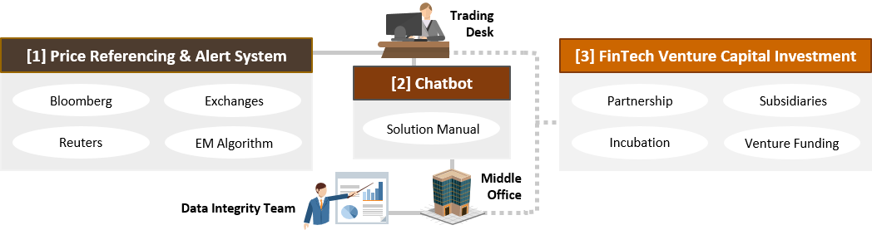

Taking Pride in Leading the Elites
ELITE BANK
Intrinsically Motivated, Technically Driven.
“Game-changing innovation
in investment banking is
no longer optional,
but imperative.”
Elite Bank holds the firm belief that smarter solution could be made simple, and the intrinsic motivation to alleviate the bank’s operation should be complemented with technological tools. Understanding, regulating and maximizing the benefit of FinTech is set to be a critical means of not only success, but also the survival in the future investment banking landscape.
Source: Fidelity, BCG Analysis, HSBC, BBVA, World Economic Forum, Elite Bank Analysis
Situation Analysis | Technological Synergy | Operational Synergy | Implementation and Benefits | Page 20

Slide 21

Navigation Slide
ELITE BANK
Situation Analysis
02 – A Glimpse of Price Discrepancy in Securities Trading
03 – Elite Bank for the Winning Edge: Synergy Overview
Technological Synergy
04 – Multisource Reference Checking and Alert System
05 – EM Algorithm for Estimation of Missing Entries and Trends
06 – [Prototype Demonstration 1.1]: EM Algorithm
07 – System Linkage with Exchange
08 – Scenario Analysis
09 – [Prototype Demonstration 1.2]: System Linkage with Exchange
Operational Synergy
10 – Chatbot for
In-House Support
11 – Scenario Analysis
12 – [Prototype Demonstration 2]: Chatbot for In-House Support
13 – Global Banking Chatbots Comparable Analysis
14 – FinTech Venture Capital Investment for Long-Term Operational Stability
Implementation and Benefits
15 – Risk Assessment and Mitigation Planning
16 – Three-Year Implementation Timeline
17 – In-House Development Cost Breakdown – Technological & Operational
20 – Taking Pride in Leading the Elites
Appendix
22 – [1]: Risk Management System (RMS)
in Trading Activities
23 – [1.1]: EM Algorithm for Estimation of Missing Entries and Trends
24 – [1.2]: Number of Subscribers for
HKEx Exchange Data
25 – [2]: Benefits of AI-Powered Chatbot
in the Banking Industry
26 – [3]: FinTech Venture Capital Investment Trends
27 – [3]: Comparative Analysis of FinTech in Banking Industry
28 – Disclaimer and Forward-Looking Statement
Situation Analysis | Technological Synergy | Operational Synergy | Implementation and Benefits | Page 21

